Slide 1

DATA STRUCURES
Java Full Stack Program

Slide 2
Data Structures
Data Structure is a particular way of storing and organizing data in a computer so that it can be used efficiently.
Different kinds of data structures are suited to different kinds of applications.
Storing and retrieving can be carried out on data stored in both main memory and in secondary memory.
Java Full Stack Program

Slide 3
ARRAYS
Array is a static data structure that represents a collection of fixed number of homogeneous data items.
A fixed-size indexed sequence of elements, all of the same type.
The individual elements are typically stored in consecutive memory locations.
The length of the array is determined when the array is created, and cannot be changed.
Java Full Stack Program

Slide 4
ARRAYS
Any component of the array can be inspected or updated by using its index.
This is an efficient operation
O(1) = constant time
The array indices may be integers (C, Java) or other discrete data types (Pascal, Ada).
The lower bound may be zero (C, Java), one (Fortran), or chosen by the programmer (Pascal, Ada)
Java Full Stack Program

Slide 5
Different Types of Arrays
One-dimensional array: only one index is used
Multi-dimensional array: array involving more than one index
Static array: the compiler determines how memory will be allocated for the array
Dynamic array: memory allocation takes place during execution
Java Full Stack Program

Slide 6
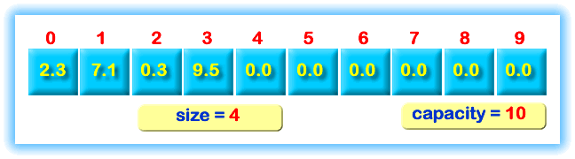
List Implemented Using Array
Java Full Stack Program

Slide 7
Disadvantages of Using Arrays
Need to define a size for array
High overestimate (waste of space)
insertion and deletion is very slow
need to move elements of the list
redundant memory space
it is difficult to estimate the size of array
Java Full Stack Program

Slide 8
Operations On Lists
We’ll consider only few operations and not all operations on Lists
Let us consider Insert
There are two possibilities:
Ordered List
Unordered List
Java Full Stack Program

Slide 9
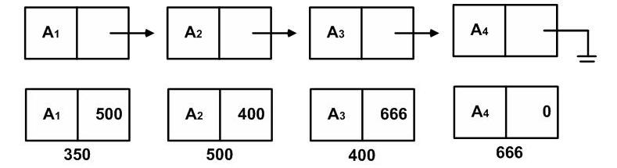
Linked List
Series of nodes
not adjacent in memory
contain the element and a pointer to a node containing its succesor
Avoids the linear cost of insertion and deletion!
Java Full Stack Program

Slide 10
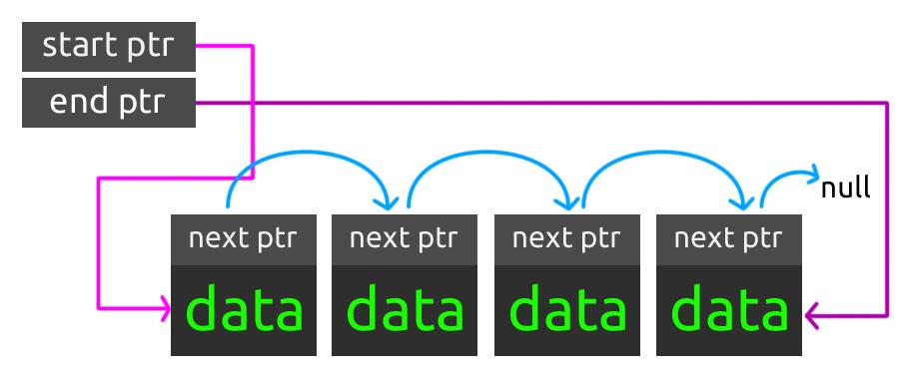
Singly Linked List
Java Full Stack Program

Slide 11
Singly Linked List
Insertion into a singly-linked list has two special cases.
It's insertion a new node before the head (to the very beginning of the list) and after the tail (to the very end of the list).
In any other case, new node is inserted in the middle of the list and so, has a predecessor and successor in the list.
Java Full Stack Program

Slide 12
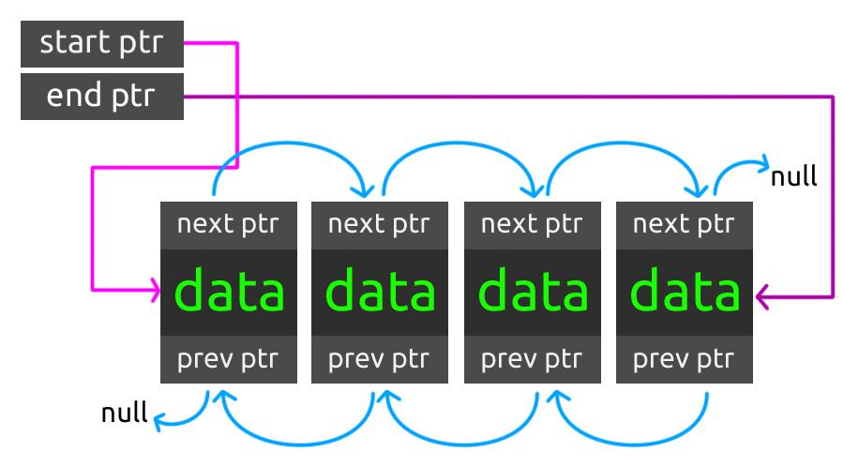
Doubly Linked List
Java Full Stack Program

Slide 13
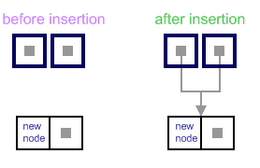
Empty list case
When list is empty, which is indicated by (head == NULL) condition, the insertion is quite simple.
Algorithm sets both head and tail to point to the new node.
Java Full Stack Program

Slide 14
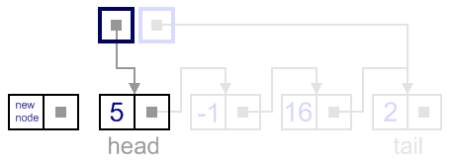
Add first
In this case, new node is inserted right before the current head node.
Java Full Stack Program

Slide 15
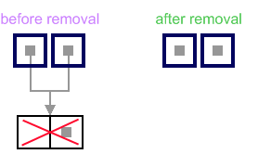
List has only one node
When list has only one node, that the head points to the same node as the tail, the removal is quite simple.
Algorithm disposes the node, pointed by head (or tail) and sets both head and tail to NULL.
Java Full Stack Program

Slide 16
Advantages of Using Linked Lists
Need to know where the first node is
the rest of the nodes can be accessed
No need to move the elements in the list for insertion and deletion operations
No memory waste
Java Full Stack Program

Slide 17
Linked Lists - Pros and Cons
Pros
Size determined during runtime
Inserting and deleting elements is quick
Cons
No random access
User must provide programming support
Java Full Stack Program

Slide 18
THANK YOU
Java Full Stack Program

